Slide 1
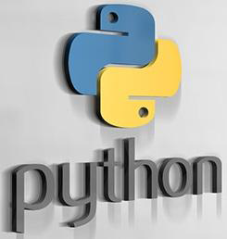

Slide 2
UNIT – VI
Contents
Working with NumPy/PlotPy/SciPy
GUI Programming
Introduction
Tkinter programming
Tkinter widgets

Slide 3
Numpy

Slide 4
Numpy: NumPy stands for Numerical Python. NumPy is a Python library used for working with arrays.
Numpy arrays
Array are by default Homogeneous, which means data inside an array must be of the same Data type.
Element wise operation is possible.
Numpy array has the various function, methods, and variables, to ease our task of matrix computation.
Elements of an array are stored contiguously in memory.
Lists
The list can be homogeneous or heterogeneous.
Element wise operation is not possible on the list.
Python list is by default 1 dimensional. But we can create an N-Dimensional list. But then too it will be 1 D list storing another 1D list
Elements of a list need not be contiguous in memory.

Slide 5
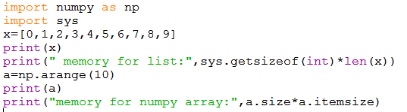

Advantages of using Numpy Arrays Over Python Lists:
consumes less memory.
fast as compared to the python List.
convenient to use.

Slide 6
Numpy: We can create a N-dimensional array or ndarray in python using numpy.if n=1,it represents a 1-D.if n=2, it represents a 2-D
To work with numpy,we shoud first import numpy module into our python programs as
import numpy
Create arrays using numpy: Creating arrays in numpy can be done in several ways
1.array():used to create an array. When we create an array, we can specify the data type of the elements either as int or float
array(lst,datatype)
2.linspace():used to create an array with evenly spaced points between a starting point and ending point
linespace(start,stop,n)
3.logspace() used to create an array with evenly spaced points on a logarithmically spaced scale
logspace(start,stop,n)
4.arange(): it is same as range()
arange(start,stop,n)
5.zeros() and ones(): zeros(n ,datatype) ones(n ,datatype)

Slide 7
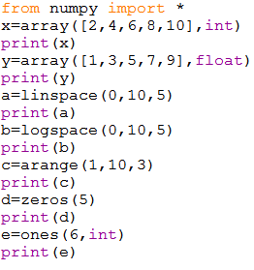
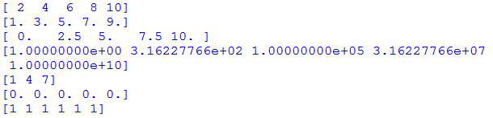
Example program for numpy arrays

Slide 8
Array Creation
We can create an array from a regular Python list or tuple using the array function. The type of the resulting array is deduced from the type of the elements in the sequences.
EX:
>>> import numpy as np
>>> a = np.array([2,3,4])
>>> a
array([2, 3, 4])
>>> a.dtype # dtype('int64')
>>> b = np.array([1.2, 3.5, 5.1])
>>> b.dtype #dtype('float64')
The type of the array can also be explicitly specified at creation time:
>>> c = np.array( [ [1,2], [3,4] ], dtype=complex )
>>> c
array([[ 1.+0.j, 2.+0.j], [ 3.+0.j, 4.+0.j]])
>>>x=np.random.randint(25,size=5)
>>> print(x) #[22 3 3 20 13]

Slide 9
y=np.random.randint(25,size=(2,3))
>>> print(y) [[22 5 15]
[23 20 17]]
a=np.random.random(5)
>>> print(a)
[0.67999849 0.38306902 0.27780021 0.23773046 0.31309768]
a=np.random.rand(5)
>>> print(a)
[0.70853614 0.10300682 0.9116366 0.96958943 0.8047125 ]
>>> b=np.random.rand(3,3)
>>> print(b) [[0.01900014 0.04698812 0.93412765]
[0.10188628 0.89378112 0.19157245]
[0.04150709 0.20763919 0.31780102]]
>>> c = np.arange(24).reshape(2,3,4) >>> print(c) [[[ 0 1 2 3]
[ 4 5 6 7]
[ 8 9 10 11]]
[[12 13 14 15]
[16 17 18 19]
[20 21 22 23]]]

Slide 10
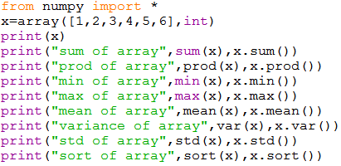
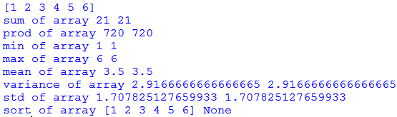
Mathematical functions in numpy

Slide 11
The attributes of an ndarray object are:
ndarray.ndim
The number of axes (dimensions) of the array.
ndarray.shape
The dimensions of the array. This is a tuple of integers indicating the size of the array in each dimension. For a matrix with nrows and m columns, shape will be (n,m). The length of the shape tuple is therefore the number of axes, ndim.
ndarray.size
The total number of elements of the array. This is equal to the product of the elements of shape.
ndarray.dtype
An object describing the type of the elements in the array. One can create or specify dtype’s using standard Python types. Additionally NumPy provides types of its own. numpy.int32, numpy.int16, and numpy.float64 are some examples.

Slide 12
ndarray.itemsize
The size in bytes of each element of the array. For example, an array of elements of type float64 has itemsize 8 (=64/8), while one of type complex32 has itemsize 4 (=32/8). It is equivalent to ndarray.dtype.itemsize.
ndarray.nbytes
The nbytes attribute gives the total number of bytes occupied by an array
Reshape():
It is useful to change the shape of an array
Flatten()
It is useful to return a copy of the array collapsed into one dimension

Slide 13
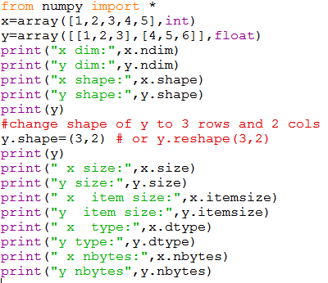
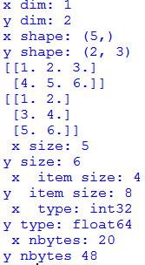
Example program

Slide 14
Working with multidimensional arrays:
The 2D arrays ,3D arrays etc. are called multi dimensional arrays
We can create multi dimensional arrays in the following ways.
1.array():is used to create a multidimensional array
a=np.array([[1,2,3,4],[5,6,7,8]])
2.Ones() and zeros() :is used to create a 2D array with several rows and columns where all the elements we be taken as 1
ones((r,c),dtype)
3.eye(): is used to create 2D array and fills the elements in the diagonal with 1s
eye(n,dtype=datatype)
4.reshape():is used to convert a 1D array inta a multidimensional array
reshape(arrayneme,(n,r,c)

Slide 15
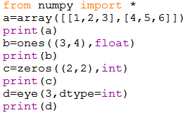
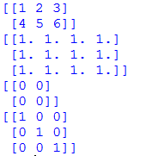
Example program
>>> a = np.random.random((2,3))
>>> a
array([[ 0.18626021, 0.34556073, 0.39676747], [ 0.53881673, 0.41919451, 0.6852195 ]])

Slide 16
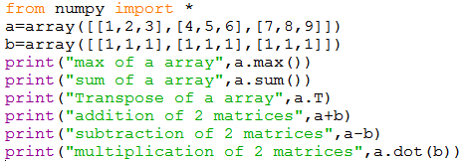
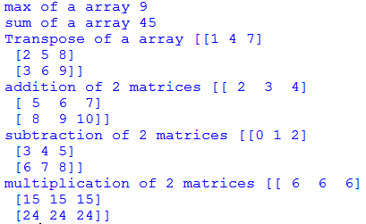
Example program

Slide 17
plotpy

Slide 18
pyplot is one of the most popular Python packages used for data visualization. It is a cross-platform library for making 2D plots from data in arrays. It can be used in python scripts, shell, web application servers and other graphical user interface toolkits.
pyplot provides a procedural interface to the matplotlib object-oriented plotting library. It is modeled closely after Matlab.
The majority of plotting commands in pyplot have Matlab analogs with similar arguments. Important commands are explained with interactive examples.

Slide 19
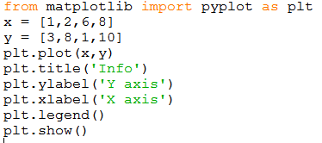
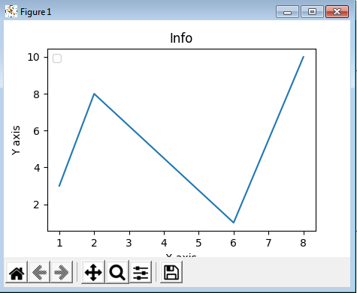
There are various plots which can be created using pyplot. Some of them are listed below
Plot ,Bar graphs, Histograms, Scatter plot and Pie charts
Plot:The plot() function draws a line from point to point.

Slide 20
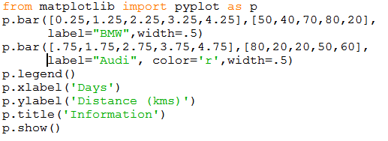
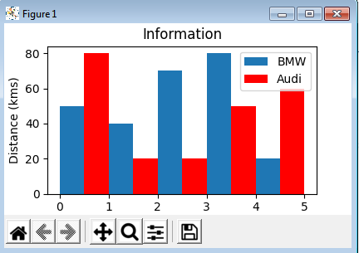
Bar graph: A bar graph uses bars to compare data among different categories. It is well suited when you want to measure the changes over a period of time. It can be represented horizontally or vertically.

Slide 21
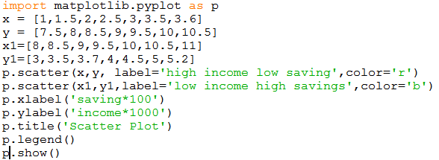
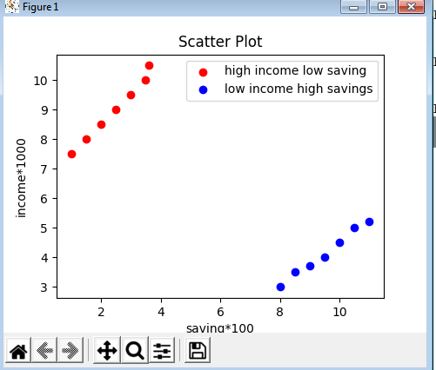
Scatter plot:we need scatter plots in order to compare variables, for example, how much one variable is affected by another variable to build a relation out of it.

Slide 22
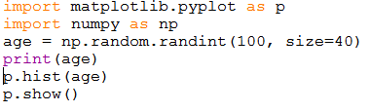
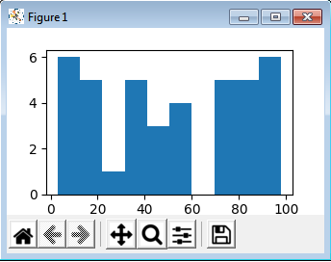
Histograms are used to show a distribution whereas a bar chart is used to compare different entities. Histograms are useful when you have arrays or a very long list.

Slide 23
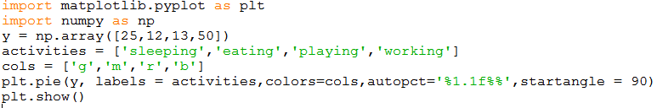
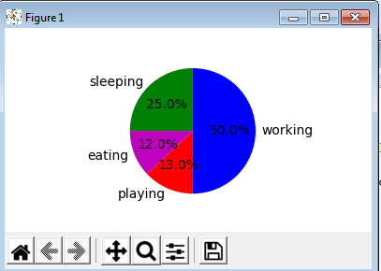
Pie charts
A pie chart refers to a circular graph which is broken down into segments i.e. slices of pie. It is basically used to show the percentage or proportional data where each slice of pie represents a category.

Slide 24
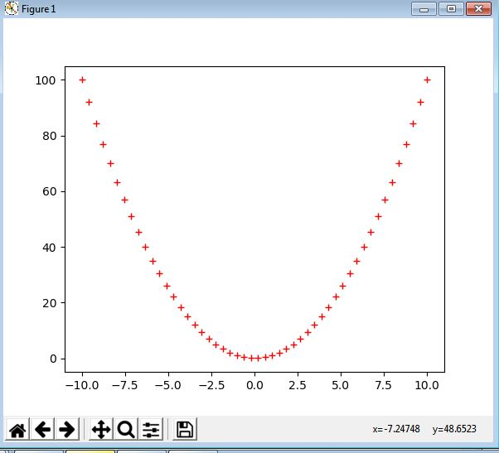
EX 1:
import matplotlib.pyplot as plt
import numpy as np
x = np.linspace(-10, 10)
plt.plot(x, x**2, 'r+')
plt.show()
Output:

Slide 25
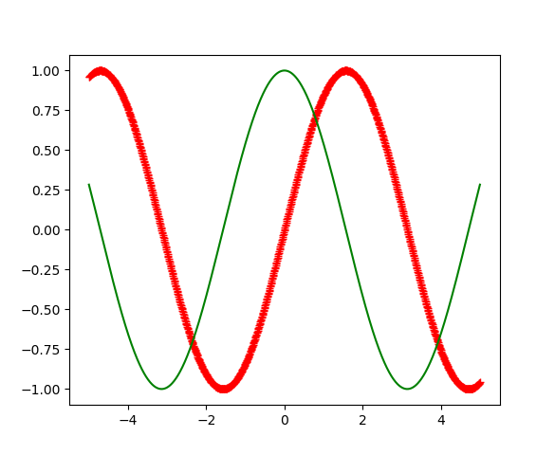
EX 2:
import matplotlib.pyplot as plt
import numpy as np
x = np.linspace(-5, 5, 1000)
plt.plot(x, np.sin(x), "r+")
plt.plot(x, np.cos(x), "g-")
plt.show()
Output

Slide 26
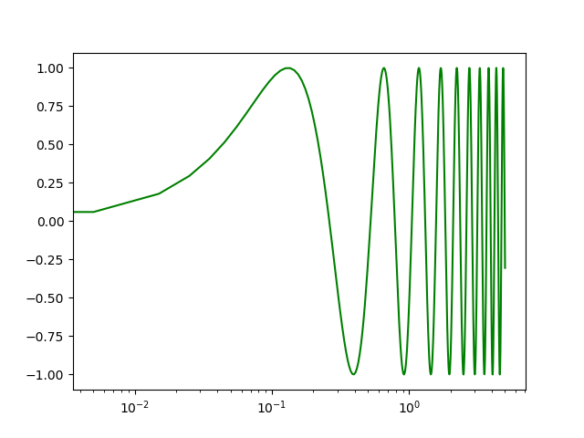
Ex 3: semilogx(*args, **kwargs)Plot curves with logarithmic x-axis scale
import matplotlib.pyplot as plt
import numpy as np
x = np.linspace(-5, 5, 1000)
plt.semilogx(x, np.sin(12*x), "g-")
plt.show()
Output

Slide 27
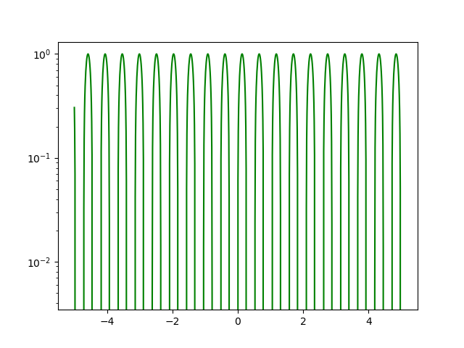
Ex 4 semilogy(*args, **kwargs)Plot curves with logarithmic y-axis scale
import matplotlib.pyplot as plt
import numpy as np
x = np.linspace(-5, 5, 1000)
plt.semilogy(x, np.sin(12*x), "g-")
plt.show()
Output

Slide 28
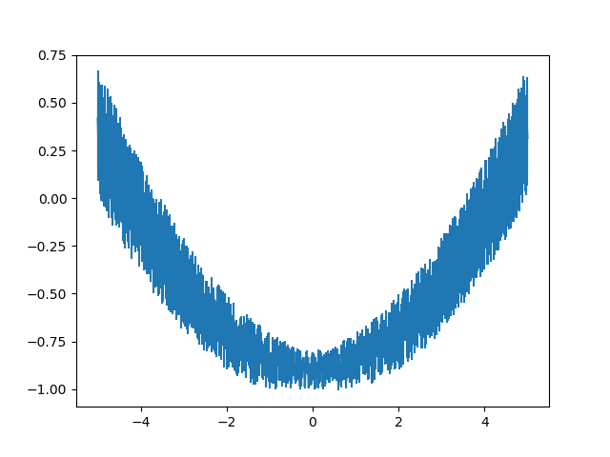
Ex 5:
import matplotlib.pyplot as plt
import numpy as np
x = np.linspace(-5, 5, 1000)
plt.errorbar(x, -1+x**2/20+.2*np.random.rand(len(x)), x/20)
plt.show()
Output

Slide 29
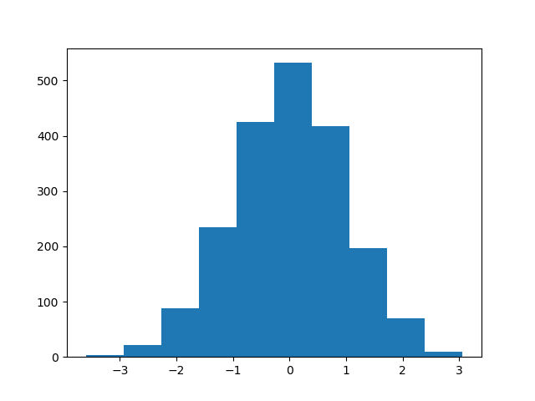
Ex 6 Plot 1-D histogram
import matplotlib.pyplot as plt
from numpy.random import normal
data = normal(0, 1, (2000, ))
plt.hist(data)
plt.show()
Output

Slide 30
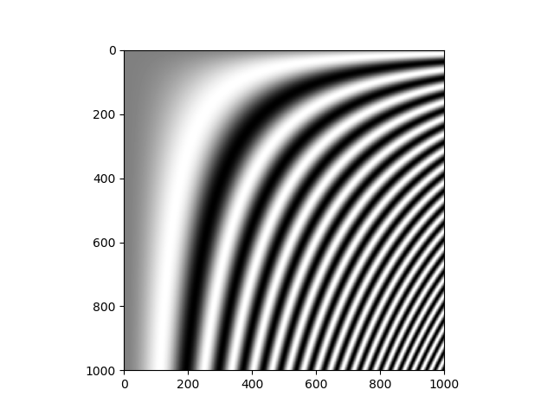
Ex 7
import matplotlib.pyplot as plt
import numpy as np
x = np.linspace(-5, 5, 1000)
img = np.fromfunction(lambda x, y: np.sin((x/200.)*(y/200.)**2), (1000, 1000))
plt.gray()
plt.imshow(img)
plt.show()
Output

Slide 31
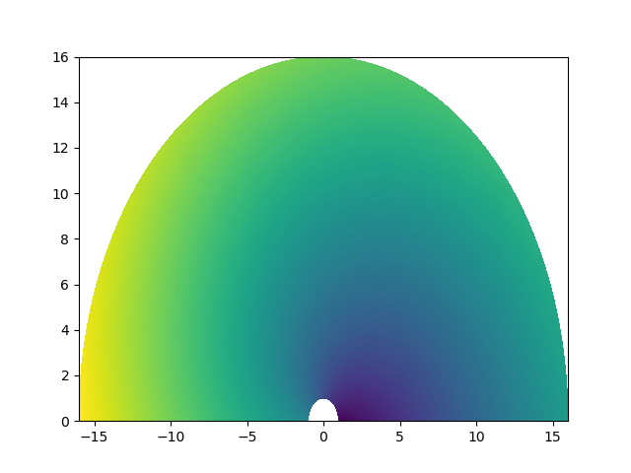
Ex 8 Create a pseudocolor plot of a 2-D array
import matplotlib.pyplot as plt
import numpy as np
r = np.linspace(1., 16, 100)
th = np.linspace(0., np.pi, 100)
R, TH = np.meshgrid(r, th)
X = R*np.cos(TH)
Y = R*np.sin(TH)
Z = 4*TH+R
plt.pcolor(X, Y, Z)
plt.show()

Slide 32
scipy

Slide 33
SciPy is a free and open-source Python library used for scientific computing and technical computing.
SciPy contains modules for optimization, linear algebra, integration, special functions, FFT, signal and image processing, solvers and other tasks common in science and engineering.
SciPy builds on the Numpy array object and is part of the Numpy stack which includes tools like Matplotlib, pandas and SymPy, and an expanding set of scientific computing libraries.

Slide 34
scipy is composed of task-specific sub-modules
scipy.cluster Vector quantization / Kmeans
scipy.constants Physical and mathematical constants
scipy.fft Fourier transform
scipy.integrate Integration routines
scipy.interpolate Interpolation
scipy.io Data input and output
scipy.linalg Linear algebra routines
scipy.ndimage n-dimensional image package
scipy.odr Orthogonal distance regression
scipy.optimize Optimization
scipy.signal Signal processing
scipy.sparse Sparse matrices
scipy.spatial Spatial data structures and algorithms
scipy.special Any special mathematical functions
scipy.stats Statistics

Slide 35
Special Functions:
SciPy provides a number of special functions that are used in mathematical physics such as elliptic, convenience functions, gamma, beta, etc.
Example:
from scipy.special import *
cb = cbrt([8, 125])
print(cb)
com = comb(5, 2)
print(com)
per = perm(5, 2)
print(per)
c = sindg(90)
print(c)
d = cosdg(45)
print(d) [2. 5.]
10.0
20.0
1.0
0.7071067811865475

Slide 36
Integration Functions:
SciPy provides a number of functions to solve integrals.
Ex:
from scipy import integrate
a = lambda y, x: x*y**2
b = lambda x: 1
c = lambda x: -1
integrate.dblquad(a, 0, 2, b, c)
Optimization Functions:
The scipy.optimize provides a number of commonly used optimization algorithms
Ex:
import numpy as np
from scipy.optimize import rosen
a = 1.2 * np.arange(5)
rosen(a)
Output:
7371.0399999999945

Slide 37
Interpolation Functions:
Interpolation refers to constructing new data points within a set of known data points.
Ex:
from scipy import interpolate
import numpy as np
x = np.arange(5, 20)
y = np.exp(x/3.0)
f = interpolate.interp1d(x, y)
Fourier Transform Functions:
Fourier analysis is a method that deals with expressing a function as a sum of periodic components and recovering the signal from those components. The fft functions can be used to return the discrete Fourier transform of a real or complex sequence.
Ex:
from scipy.fftpack import fft, ifft
x = np.array([0,1,2,3])
y = fft(x)
print(y)

Slide 38
io module SciPy has many modules, classes, and functions available to read data from and write data to a variety of file formats.
EX
import numpy as np
from scipy import io as spio
a = np.ones((3, 3))
spio.savemat('file.mat', {'a': a})
data = spio.loadmat('file.mat')
print(data['a'])
Output
[[1. 1. 1.]
[1. 1. 1.]
[1. 1. 1.]]

Slide 39
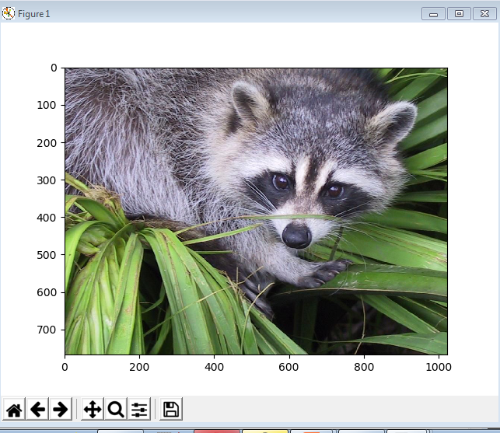
scipy.ndimage is a submodule of SciPy which is mostly used for performing an image related operation
EX
import scipy
from scipy import misc
import matplotlib.pyplot as plt
face=scipy.misc.face()
print(face.shape)
print(face.max())
print(face.dtype)
plt.gray()
plt.imshow(face)
plt.show()
Output
(768, 1024, 3)
255
uint8

Slide 40
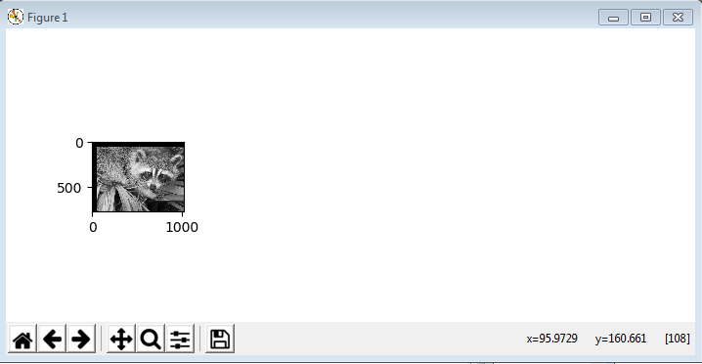
import scipy
from scipy import ndimage,misc
import matplotlib.pyplot as plt
face=misc.face(gray=True)
shifted_face = ndimage.shift(face, (50, 50))
plt.figure(figsize=(15, 3))
plt.subplot(151)
plt.imshow(shifted_face,cmap=plt.cm.gray)
plt.show()
Output

Slide 41
GUI Programming

Slide 42
Introduction
A person who interacts with a software or application is called a user.
Two ways for a user to interact with any application.
Character User Interface
The user gives some commands to perform the work
Graphical User Interface
The user interacts with an application through Graphics or pictures or images.
Advantages of GUI
User friendly
It adds attraction and beauty to any application by adding pictures, colors, menus, animations etc.
possible to simulate the real life objects.
It helps to create graphical components like push button, radio button, check button etc.

Slide 43
Tkinter programming
Python offers Tkinter module to create graphics programs
Tkinter represents toolkit interface for GUI
We can enable the interface by using the classes of Tk module of TCL/TK language(Tool command Language).
TCL is a dynamic programming language suitable for web and desktop applications, networking, administration, testing etc.

Slide 44
The following steps are involved in basic GUI programs
We should create the root window. The root window is the top level window provides rectangular space on the screen where we display text, colors, images, components etc.
In the root window , the space allocation is done by Frame or canvas. These are child windows of root window.
We use canvas for displaying drawings like lines, arcs, circles, shapes etc.
The frame is used for displaying components like push buttons, check buttons, menus etc. These are called widgets.

Slide 45
Root window
To display the graphical output , the space is allocated to any GUI program called top level window or root window.
We can reach this root window by creating an object to the class.
The root window will have a title bar that contains minimize, resize and close options.
EX
# creating root window
from tkinter import *
root = Tk()
root.title(“my window”)
root.geometry(“400x300”)
root.mainloop()

Slide 46
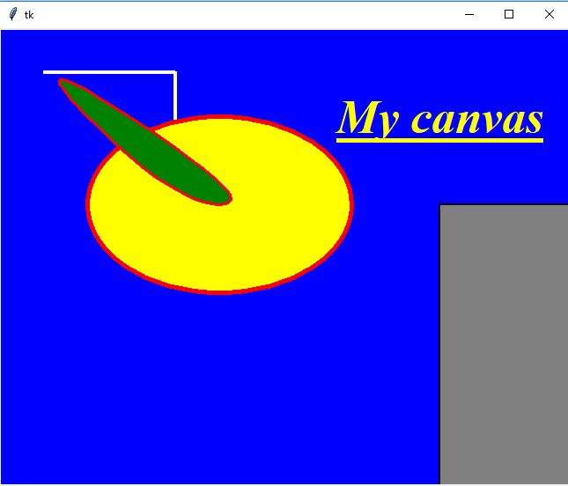
Canvas: This is a container which is used to draw shapes like lines, curves ,arcs and circles
c=Canvas(master , option=value…..)
from tkinter import *
w1=Tk()
c=Canvas(w1,bg="blue",height=700,width=1200,cursor="pencil")
id=c.create_line(50,50,200,50,200,150,width=4,fill="white")
id=c.create_oval(100,100,400,300,width=5,fill="yellow",outline="red",activefill="green")
id=c.create_polygon(10,10,200,200,300,200,width=3,fill="green",outline="red",
smooth=1,activefill="lightblue")
id=c.create_rectangle(500,200,700,600,width=2,fill="gray",outline="black",
activefill="yellow")
fnt=("Times",40,"bold italic underline")
id=c.create_text(500,100,text="My canvas",font=fnt,fill="yellow",
activefill="green")
c.pack()
w1.mainloop()

Slide 47

Frame:This is a container which is used to display widgets like buttons,checkbuttons or menu
f=Frame(master,option=value,-----)
Button: It is used to display buttons in your application
b=Button(master, text=“submit”, command=function,option=value,…….)
from tkinter import *
def Clickme(self):
print("you have clicked me")
w=Tk()
f=Frame(w,height=200,width=300).pack()
b=Button(f,text="My Button",width=15,height=2,bg="yellow",fg="blue",
activebackground="green",activeforeground="red“, command=Clickme())
w.mainloop()

Slide 48
Widgets: A widget is aGUI component that is displayed on the screen and can perform a task as desired by the user. We create widgets as objects.
Button
Label
Checkbutton
Radiobutton
Entry
Spinbox
Listbox
Text
Message
Scrollbar
Menu

Slide 49
Layout Management: once we create widgets or components, we can arrange them in the frame in a particular manner. Arranging the widgets in the frame is called layout management. There are three types of layout managers.
1.Pack layout manager: It uses pack() method which associate a widget with its parent component. While using the pack() method, we can mention the position of the widget using fill or side options. The fill option can take the values X, Y,BOTH,NONE. The value X represents that the widget should occupy the frame horizontally, The value Y represents that the widget should occupy the frame vertically. Both represents that the widget should occupy the frame horizontally. The option side which is used to place the widgets side by side.’ side ‘ can take the values LEFT,RIGHT,TOP or BOTTOM. The default value is TOP
b1.pack(side=Left)
b1.pack(fill=x)
2.Grid layout manager :It uses the grid() method to arrange the widgets in a two dimensional table that contains rows and columns. The position of a widget is defined by a row and column number
b.grid(row=0,column=0)
3.Place layout manager: It uses the place() method to arrange the widgets.The position of the widget is defined by x and y coordinates
b1.place(x=10,y=80)

Slide 50
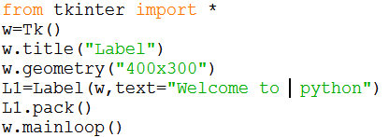
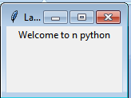

Label :The Label widget is used to provide a single-line caption for other widgets. It can also contain images.
l1=Label(master , text=“ hello", option=value,….)
from tkinter import *
class MyButtons:
def __init__(self,w):
self.b1=Button(w,text="ClickMe“,width=15,height=2,command=self.buttonClick)
self.b2=Button(w,text="close",width=15,height=2,command=w.destroy)
self.b1.grid(row=0,column=1)
self.b2.grid(row=0,column=2)
def buttonClick(self):
self.lbl=Label(w,text="welcometopython",width=20,height=2,
font=("Courier",-30,"bold underline"),fg="blue")
self.lbl.grid(row=2,column=0)
w=Tk()
mb=MyButtons(w)
w.mainloop()

Slide 51
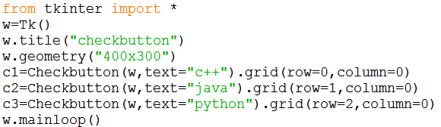
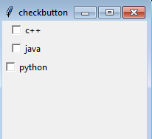
Checkbutton:The Checkbutton widget is used to display a number of options as checkboxes. The user can select multiple options at a time.
c= Checkbutton(master , text=‘submit ’, variable=var1,command=function , option=value……)

Slide 52
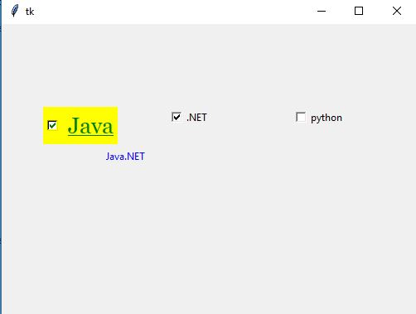
from tkinter import *
class Mycheck:
def __init__(self,w):
self.var1=IntVar()
self.var2=IntVar()
self.var3=IntVar()
self.c1=Checkbutton(w, text="Java“, variable=self.var1,command= self.display)
self.c2=Checkbutton(w,text=".NET“,variable=self.var2,command= self.display)
self.c3=Checkbutton(w,text="python",variable=self.var3,command= self.display)
self.c1.place(x=50,y=100)
self.c2.place(x=200,y=100)
self.c3.place(x=350,y=100)
def display(self):
x=self.var1.get()
y=self.var2.get()
z=self.var3.get()
str=''
if x==1:
str+="Java"
if y==1:
str+=".NET"
if z==1:
str+="python"
lbl=Label(text=str,fg="blue").place(x=50,y=150,width=200,height=20)
w=Tk()
mb=Mycheck(w)
w.mainloop()

Slide 53
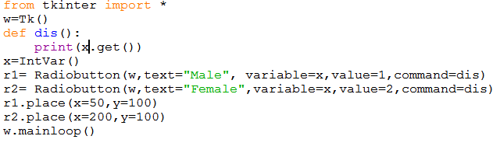
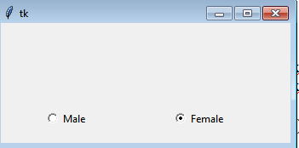
Radiobutton :The Radiobutton widget is used to display a number of options as radio buttons. The user can select only one option at a time.
r= Radiobutton( master, text=“option1”,variable=z , value=1,command=fun,…..)

Slide 54
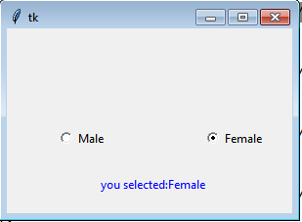
from tkinter import *
class Myradio:
def __init__(self,w):
self.var=IntVar()
self.r1= Radiobutton(w,text="Male“, variable=self.var ,value=1,command= self.display)
self.r2= Radiobutton(w,text="Female“ , variable=self.var ,value=2,command=self.display)
self.r1.place(x=50,y=100)
self.r2.place(x=200,y=100)
def display(self):
x=self.var.get()
str=''
if x==1:
str+="you selected:Male"
if x==2:
str+="you selected:Female"
lbl=Label(text=str,fg="blue").place(x=50,y=150,width=200,height=20)
w=Tk()
mb=Myradio(w)
w.mainloop()

Slide 55
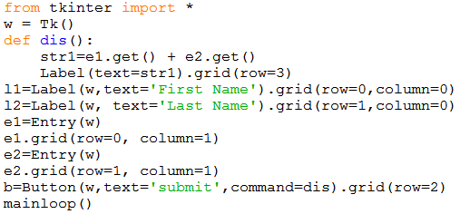
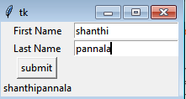
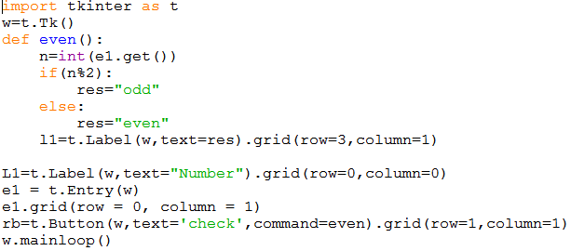
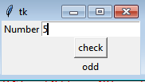
Entry :The Entry widget is used to display a single-line text field for accepting values from a user.
e=Entry(master , option=value,….)

Slide 56
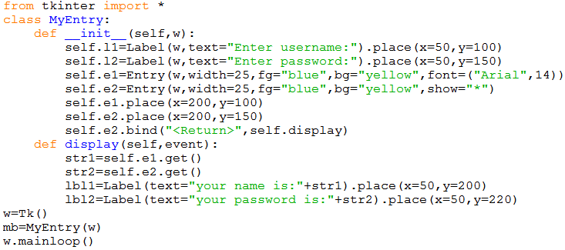
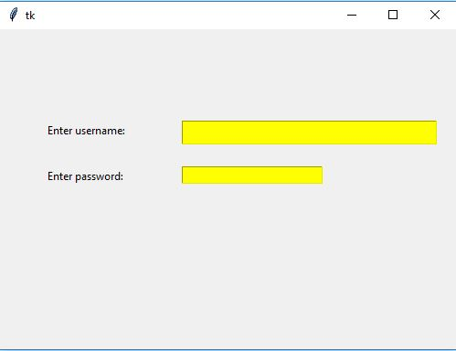

Slide 57
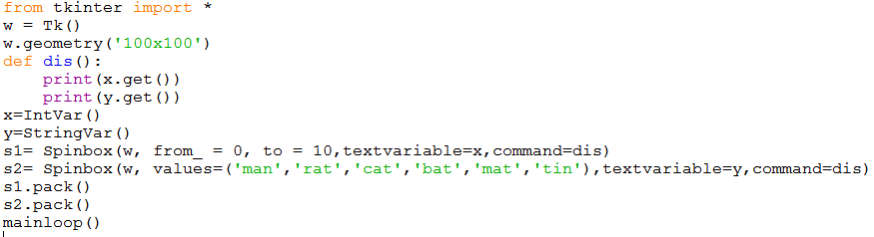
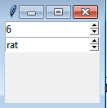
Spin box: It allows the user to select the values from a given set of values. The values may be a range of numbers or a fixed set of strings
S= Spinbox (master , from_=4,to=15,textvariable= var, command=fun,……..)
S= Spinbox (master , values=(‘a’,’b’,’c’),textvariable= var, command=fun,……..)

Slide 58
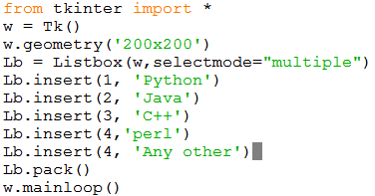

List box:It displays a list of items in a box so that the user can select one or more items
l1= Listbox (master ,selectmode=“multiple”,.. …)

Slide 59


Message: It is used to display multiple lines of text
m=Message(master,text=str1,option=value1,…….)
Text : It is same as a label or message and used to display multiple lines of text in different colors and fonts.
T=Text(master,option=value,……….)

Slide 60


Scrollbar: The Scrollbar widget is used to add scrolling capability to various widgets, such as list boxes.
s=Scrollbar(master,option=value,……)

Slide 61


Menu: It is used to create all kinds of menus used by the application.
m=Menu(master,option=value,……..)

